Slide 1
LOW-NOISE AMPLIFIER DESIGN FOR 60GHZ APPLICATIONS
Major project
Presented By: Shivam Gupta
ECE 17101043
Supervised By: Dr. Bipin Chandra Mandi
Assistant Professor, ECE ,
IIIT Naya Raipur

Slide 2
What is a LNA ?
A low-noise amplifier or LNA is an electronic amplifier that is used to amplify signals of very low strength, usually from an antenna where signals are barely recognizable and should be amplified without adding any noise, otherwise important information might be lost. LNAs are one of the most important circuit components present in radio and other signal receivers.

Slide 3
A RF Receiver
Antenna
BPF1
LNA
BPF2
Mixer
BPF3
IF Amp
Demodulator
RF front end
LO

Slide 4
Why 60 ghz ?
V-Band millimeter-wave communication is a next-generation technology designed to meet the higher bandwidth demands of 5G wireless applications.
As customer demands grows for faster and reliable internet connections for various services such as live-video streaming but the operational spectrum and bandwidth of 4G and 3G are constrained to less than 6GHz and already occupied by different applications.
5G millimetre wave (30 to 300 GHz) networks are promising solution for user requirements. As per the result of survey, 60GHz band is recommended due to the high data rate and very high throughput.

Slide 5
LNA Design Consideration
Gain
Noise figure
Input/ Output Impedance matching
Bandwidth
Stability
Linearity

Slide 6
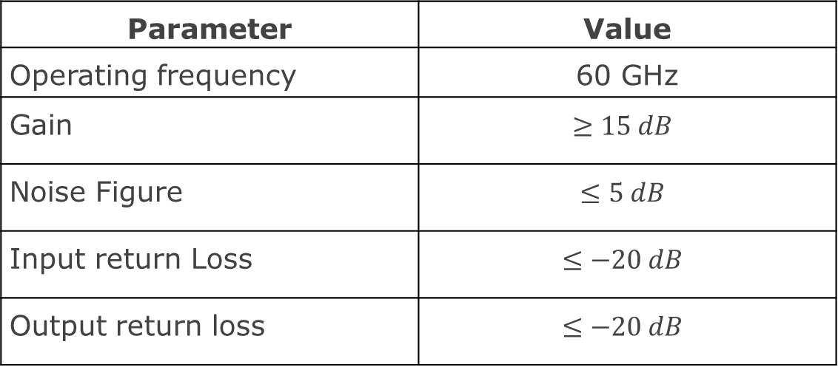
Objectives
Objective is to design a two stage cascoded CMOS LNA with following specifications:
First stage is for Gain and second stage for Linearity and Stability.
Cascode structure help to improve isolation.
Parameter | Value
Operating frequency | 60 GHz
Gain | $$≥15 dB$$
Noise Figure | $$≤5 dB$$
Input return Loss | $$≤−20 dB$$
Output return loss | $$≤−20 dB$$

Slide 7
Tools And Technology
Tools : Virtuoso Schematic Composer and Spectre
Simulator from Cadence Design Systems, Inc.
Technology : 90 nm CMOS process (gpdk090 package)

Slide 8
CMOS LNA Design
i₁
R_{g}
C_{gd}
i₂
i₂
i₁
C_{db}
C_{gs}
V’_{gs}
V₂
V₁
r_{ds}
V_{s}
V₂
r_{i}
g_{m}V’_{gs}
Above diagram show high frequency small signal model of a mosfet.
At high frequencies, parasitic capacitance become dominant.

Slide 9

CMOS Amplifier Noise Figure
From above model, current gain of amplifier can be given by
$i_{2}=g_{m} V_{gs}=g_{m}\frac{V_{1}}{R_{s}+R_{g}+\frac{1}{jωC_{gs}}}\left(\frac{1}{jωC_{gs}}\right)≈$ $V_{1}\frac{g_{m}}{jωC_{gs}(R_{s}+R_{g})}$
This can be rewritten as $i_{2}$ = $G_{m}$ $V_{gs}$, where
$$G_{m}=\frac{ω_{T}}{jωC_{gs}(R_{s}+R_{g})}$$

Slide 10


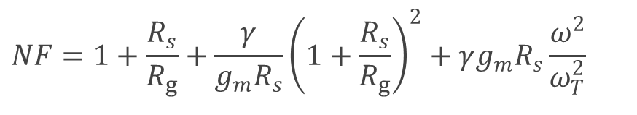
This facilitates the noise calculations since the total noise is given by
And the noise figure is easily computed
Substitution of the various noise sources leads to (Rs>>Rg)
$$NF=1+\frac{R_{s}}{R_{g}}+\frac{γ}{g_{m}R_{s}}{\left(1+\frac{R_{s}}{R_{g}}\right)}^{2}+γg_{m}R_{s}\frac{ω^{2}}{ω_{T}^{2}}$$

Slide 11
CMOS LNA Topologies
There are many Topologies available such as,
Resistive termination
Series-shunt feedback
Common-gate connection
Inductor degeneration
In this project, Inductor degeneration is chosen as it offers narrow band matching and best noise performance with more degree of freedom.

Slide 12
Source Inductor Degeneration
Z_{in}
R_{s}
L_{g}
i_{out}
R_{s}
L_{g}
i_{in}
C_{gs}
V_{gs}
V_{s}
V_{in}
L_{s}
V_{s}
L_{s}
The reactive feedback from an inductor produces a broadband programmable real input impedance that can simplify matching (or even eliminate it altogether).
The input impedance behaves like a series RLC circuit. We need to tune the resonant frequency of the series circuit to align with the operating frequency. This has been done by adding gate inductance Lg.

Slide 13
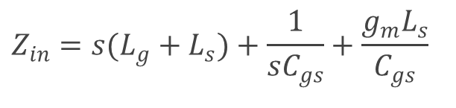
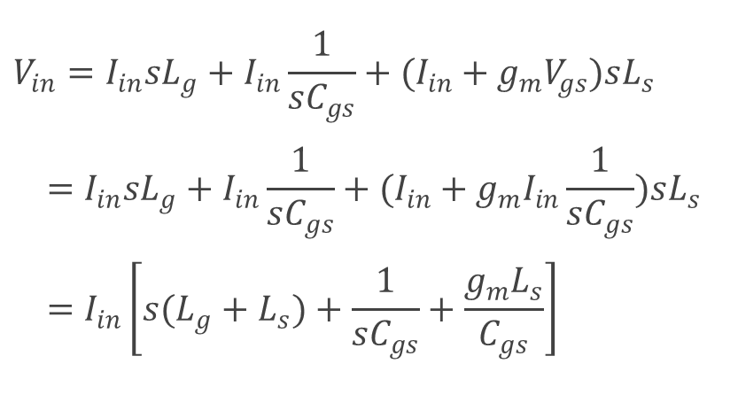
The input impedance of the MOSFET with inductive degeneration is given by
$$V_{in}=I_{in}sL_{g}+I_{in}\frac{1}{sC_{gs}}+(I_{in}+g_{m}V_{gs})sL_{s} \\ =I_{in}sL_{g}+I_{in}\frac{1}{sC_{gs}}+(I_{in}+g_{m}I_{in}\frac{1}{sC_{gs}})sL_{s} \\ =I_{in}\left[s(L_{g}+L_{s})+\frac{1}{sC_{gs}}+\frac{g_{m}L_{s}}{C_{gs}}\right]$$
Hence,
$$Z_{in}=s(L_{g}+L_{s})+\frac{1}{sC_{gs}}+\frac{g_{m}L_{s}}{C_{gs}}$$

Slide 14

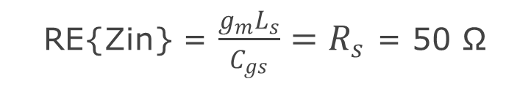
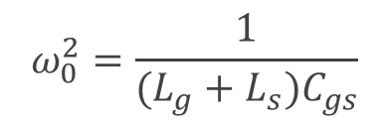
Input Matching For Inductive Degeneration
From above we can how adding source inductor create a matching network and by adding a gate inductor we increased degree of freedom to choose resonance frequency.
Hence, to match input we simply put real part of Zin equal to Rs which is 50 ohms.
And to get operating frequency we put imaginary part to zero
RE{Zin} = $\frac{g_{m}L_{s}}{C_{gs}}=R_{s}$ = 50 Ω
$$ω_{0}^{2}=\frac{1}{(L_{g}+L_{s})C_{gs}}$$
$$\text{IM}\text{\{}\text{Zin}\text{\}} \text{=}\text{ 0, }\text{this} \text{implies} \text{that}$$

Slide 15
Effective Transconductance
In a resonant circuit, the voltage across the reactive elements is Q
times larger than the voltage across the resistor.
At resonance, the voltage across the resistors is simply vs, so we have
R
s
L
g
+
+
s
1
Qv
−
Q
=
v
s
ω
C
gs
2
R
−
L
s
0
s
g
m
ω
T
1
G
=
Qg
=
=
m
m
ω
C
2
R
ω
2
R
0
gs
s
0
s

Slide 16

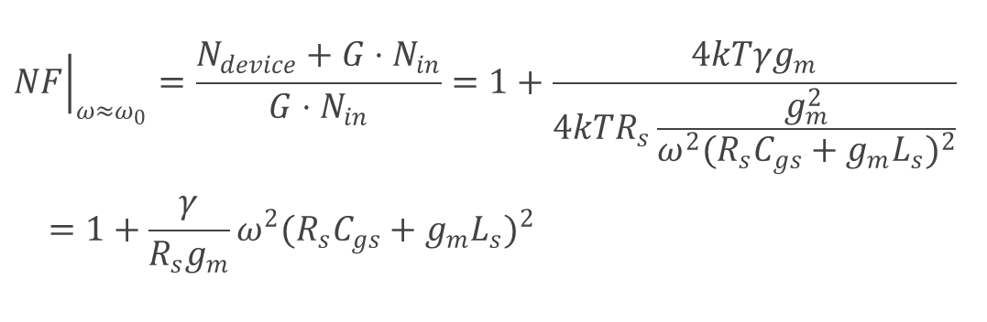
Noise Factor Of ID Structure
Similarly from equivalent circuit, Noise factor at resonant frequency can be given by
$${\left.NF\right|}_{ω≈ω_{0}}=\frac{N_{device}+G⋅N_{in}}{G⋅N_{in}}=1+\frac{4kTγg_{m}}{4kTR_{s}\frac{g_{m}^{2}}{ω^{2}(R_{s}C_{gs}+g_{m}L_{s})^{2}}} \\ =1+\frac{γ}{R_{s}g_{m}}ω^{2}(R_{s}C_{gs}+g_{m}L_{s})^{2}$$
$$=1+\frac{γ}{R_{s}g_{m}}\frac{1}{Q_{in}^{2}}$$

Slide 17
Cascoding
It’s very common to use a cascode device instead of a common source device.
This simplifies matching since the cascode device is nearly unilateral.
It improve Isolation at high frequency
Small range at Vd1
Reduced feedback effect of Cgd
Also Improve noise performance.
L_{L}
V_{bias}
N₂
R_{s}
L_{g}
V_{d1}
N₁
V_{s}
L_{s}

Slide 18
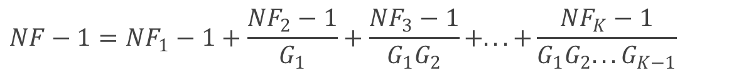
Single Stage Vs Multi Stage
In compared to single stage LNAs, multi stage LNAs offer better gain. Cof multi-stage LNA is not impaired. This may be demonstrated using the Frees noise equation.
Sin/Nin
G1, N1, NF1
Gi, Ni, NFi
GK, NK, NFK
Sout/Nout
$$NF−1=NF_{1}−1+\frac{NF_{2}−1}{G_{1}}+\frac{NF_{3}−1}{G_{1}G_{2}}+...+\frac{NF_{K}−1}{G_{1}G_{2}...G_{K−1}}$$
Unfortunately, two stage LNA has a high DC power consumption and so is not appropriate for low power applications.

Slide 19
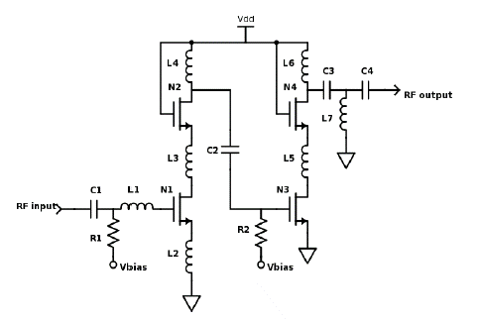
Proposed LNA
The two stage (source degeneration in first stage) cascade LNA schematic is shown in Figure. It also depicts the fundamental construction of a cascaded input transistor. Where N1 is the input transistor and N2 is the cascade transistor similarly in second stage N3 in at output node and N4 is cascade.
Both stages have been powered by 1.2 V power supply.
gm has been fixed at 12 ms and dc current of 5mA to keep mosfet in saturation and moderate inversion region.
Hence the width of nmos is 30um.
Proposed LNA Schematic

Slide 20

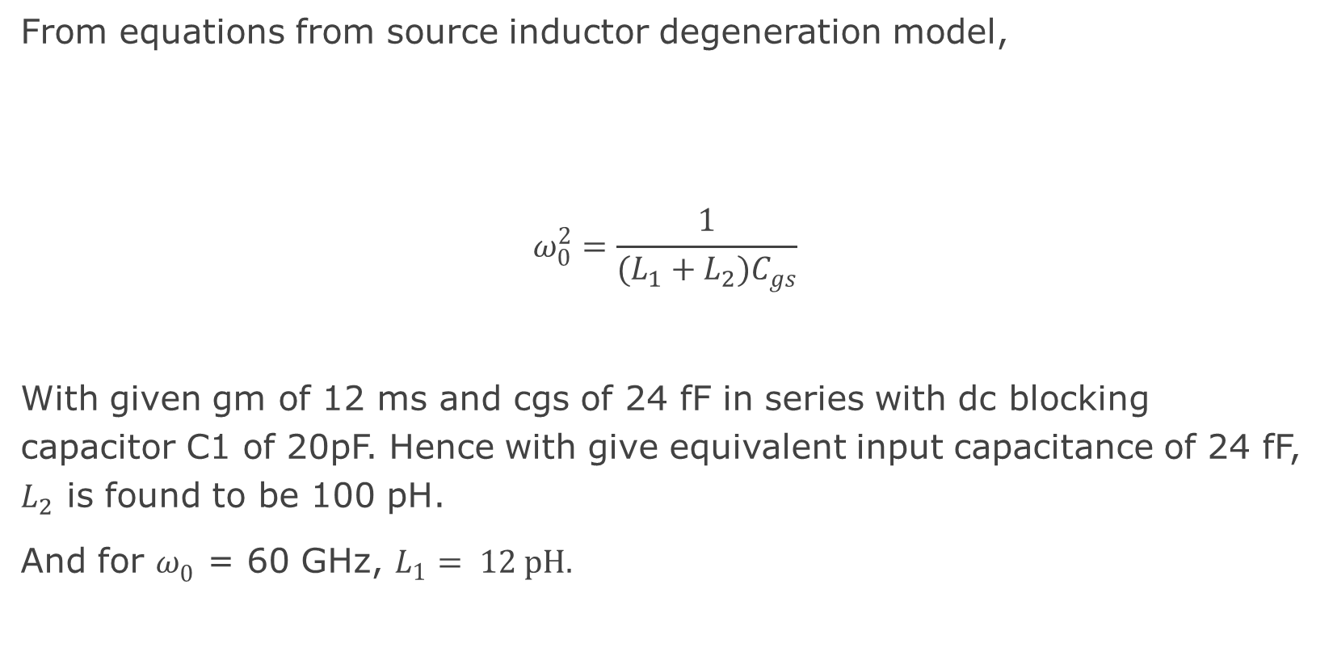
From equations from source inductor degeneration model,
$$ω_{0}^{2}=\frac{1}{(L_{1}+L_{2})C_{gs}}$$
With given gm of 12 ms and cgs of 24 fF in series with dc blocking capacitor C1 of 20pF. Hence with give equivalent input capacitance of 24 fF, $L_{2}$ is found to be 100 pH.
And for $ω_{0}^{ }$ = 60 GHz, $L_{1}= 12 pH.$
$\frac{g_{m}L_{s}}{C_{gs}}=R_{s}$ = 50 Ω

Slide 21
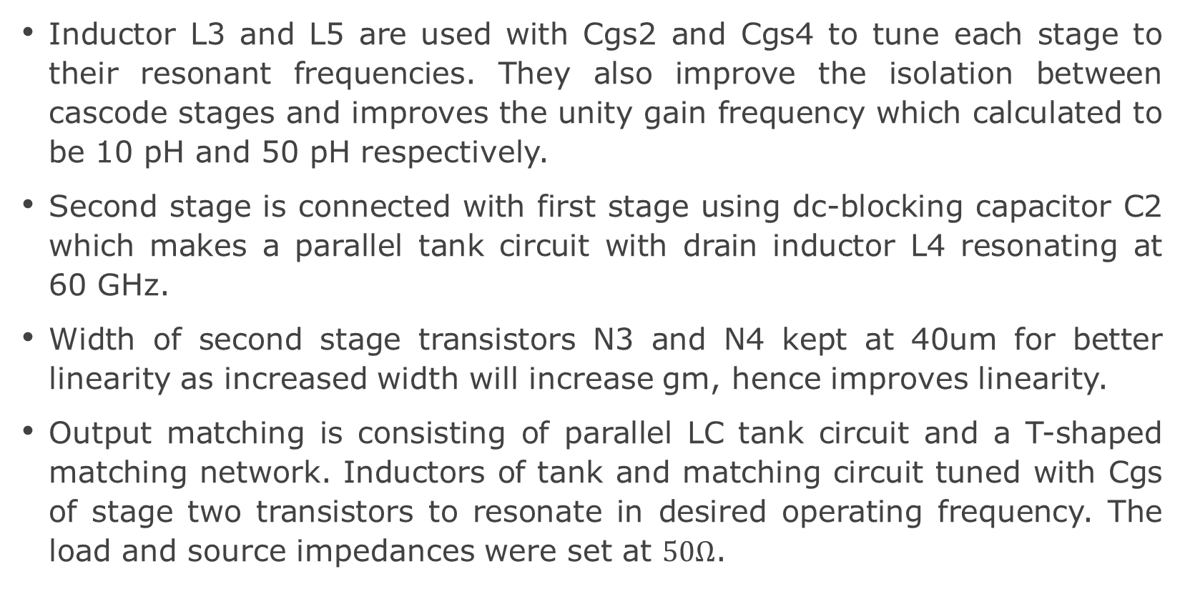
Inductor L3 and L5 are used with Cgs2 and Cgs4 to tune each stage to their resonant frequencies. They also improve the isolation between cascode stages and improves the unity gain frequency which calculated to be 10 pH and 50 pH respectively.
Second stage is connected with first stage using dc-blocking capacitor C2 which makes a parallel tank circuit with drain inductor L4 resonating at 60 GHz.
Width of second stage transistors N3 and N4 kept at 40um for better linearity as increased width will increase gm, hence improves linearity.
Output matching is consisting of parallel LC tank circuit and a T-shaped matching network. Inductors of tank and matching circuit tuned with Cgs of stage two transistors to resonate in desired operating frequency. The load and source impedances were set at $50Ω$.

Slide 22
Simulation And Results

Slide 23
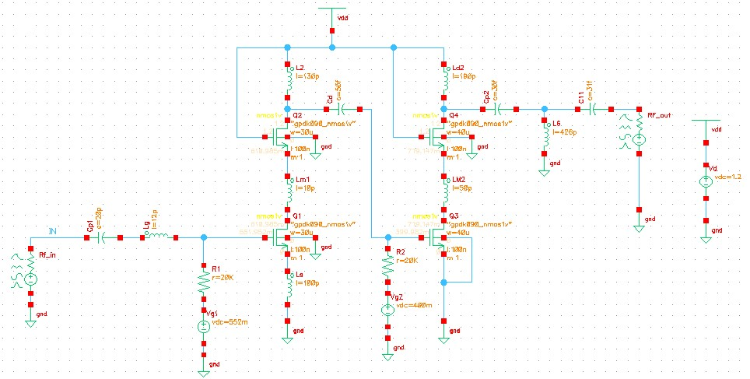
Proposed CMOS LNA circuit has been simulated in Cadence Virtuoso using gpdk090 (90nm) technology.

Slide 24
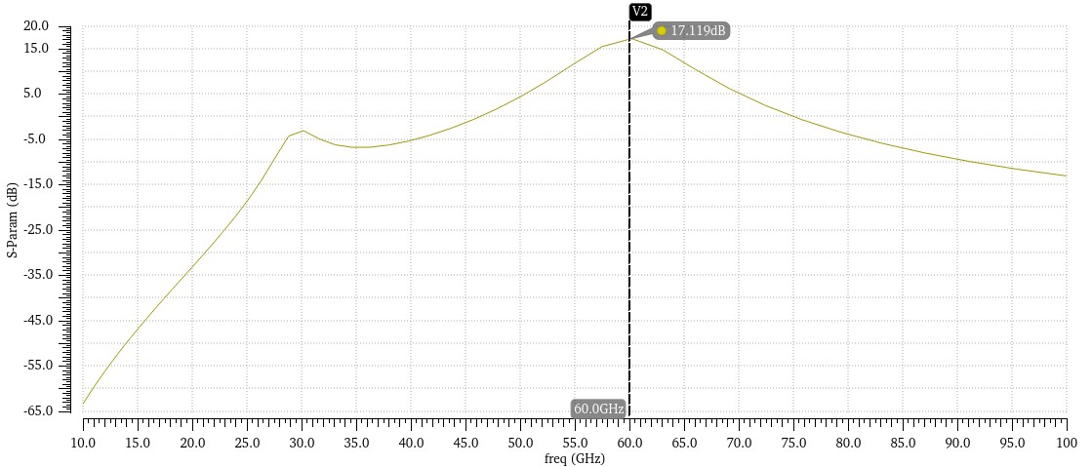
Power Gain And Available Gain
After simulation in Cadence, At 60 GHz, the maximum power gain is 17.11 dB and the available gain is 17.08 dB. From 58 GHz to 63 GHz, the power gain of the LNA is more than 15 dB.
Power Gain

Slide 25
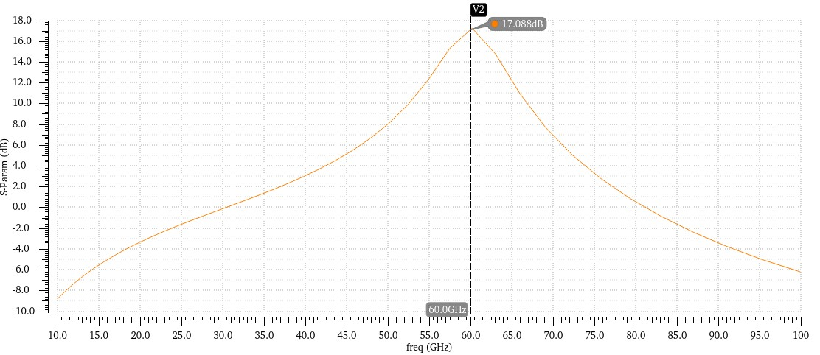

Available gain is $G_{A}=\frac{P_{available from network}}{P_{available from source}}$.
The 3-db bandwidth is 54.5 GHz to 64 GHz as seen from the gain plot.
Available Gain

Slide 26
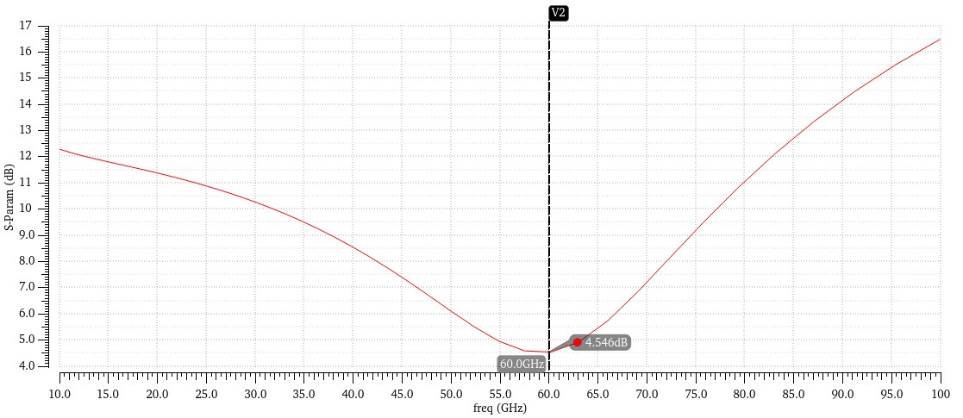
Noise Factor
After the simulating the proposed circuit, we got Noise Figure of 4.5dB as shown in plot which is less than 5dB hence in accordance with our objective.
Noise Factor

Slide 27
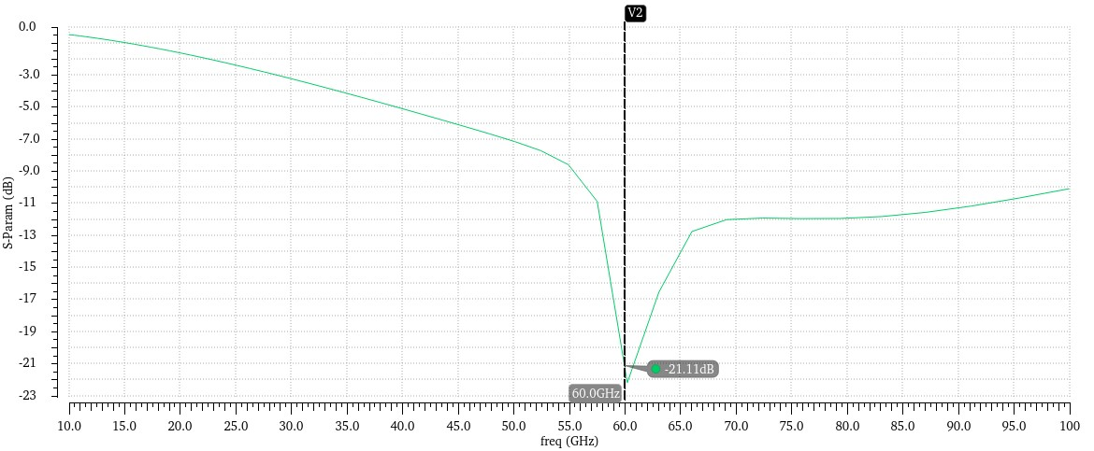
Input And Output Return Losses
Simulated Input return loss (S11) found to be -21.11 dB and output return loss (S22) found to be -24.53 dB as shown in below plots.
Input Return Loss

Slide 28
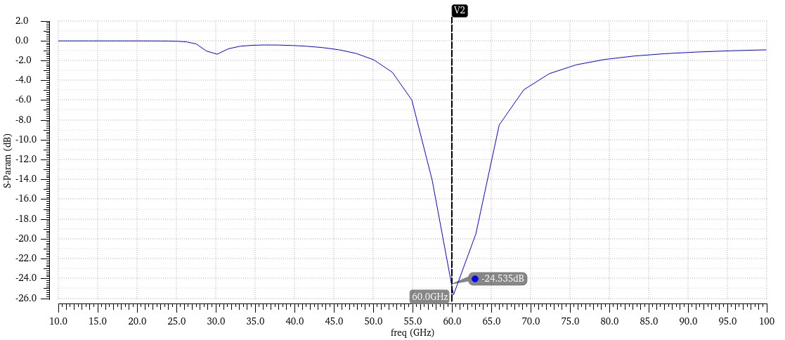
Output return loss at -24 dB as with our objective.
Output Return Loss

Slide 29
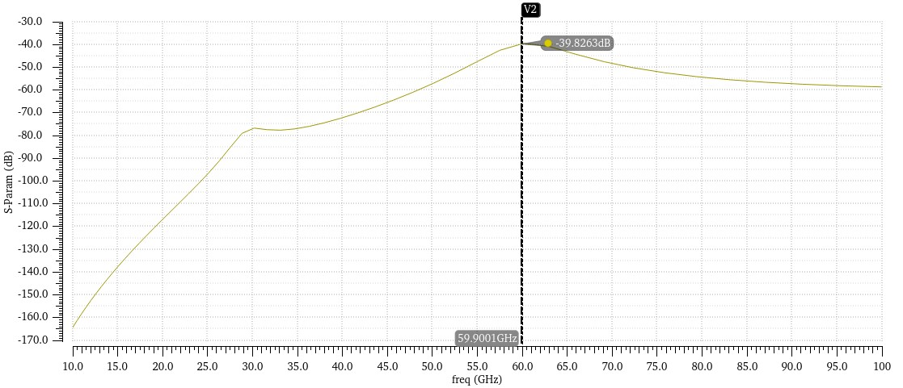
Reverse Isolation
Reverse Isolation (S12) is determined to be -39.82 dB at the target frequency of 60GHz, as illustrated in plot.
Reverse Isolation

Slide 30
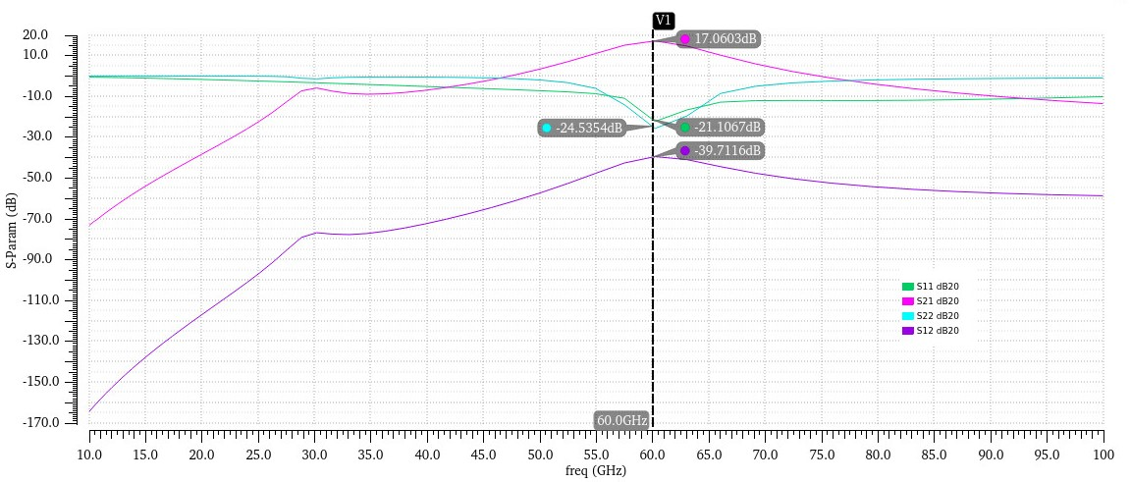
S- Parameters Summary

Slide 31

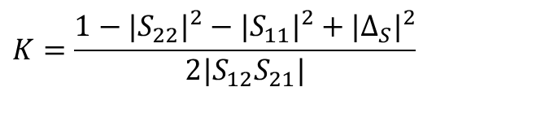
Stability
Stability is a major concern in RF amplifiers. It is obvious that an LNA may become an oscillator if it is unstable in the circuit performance. After circuit designing its stability should be examined by the designer. The degree of an amplifier’s stability can be quantified by a so-called stability factor. The stability of a circuit is characterized by the stern stability factor given
Where,
Amplifier considered to be unconditionally stable if K>1.
$$K=\frac{1−|S_{22}|^{2}−|S_{11}|^{2}+|Δ_{S}|^{2}}{2|S_{12}S_{21}|}$$
$$Δ_{S}=S_{11}S_{22}−S_{12}S_{21}$$

Slide 32
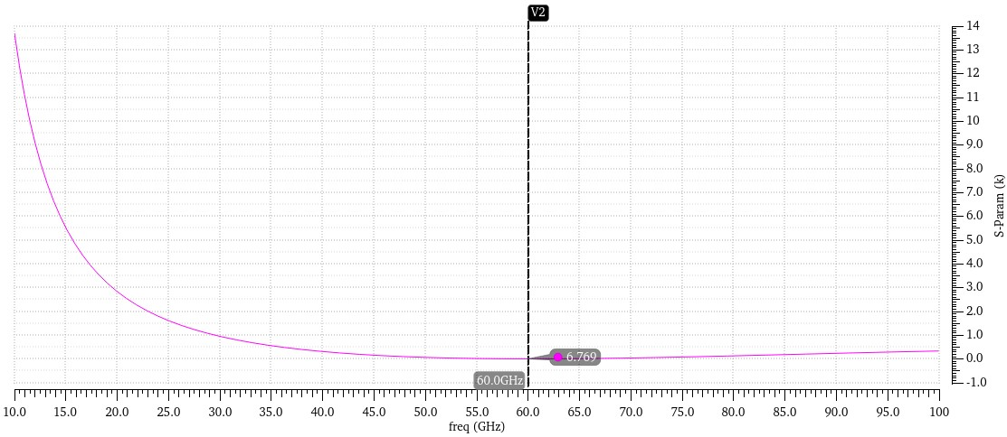
As shown in below plot, the value of stability factor (K) is 6.7 which is more than one over the frequency ranges. Hence, it is unconditionally stable.
Stability Factor

Slide 33
Linearity
Gain reduction due to the nonlinearity of the transfer function of the amplifying device is called gain compression.
The 1-dB compression point is the one of the technique to measure gain compression. It is defined as the input signal level for which the gain of the amplifier drops by 1-dB.
By the help of 1-dB compression point we can calculate the maximum input range of our design.

Slide 34
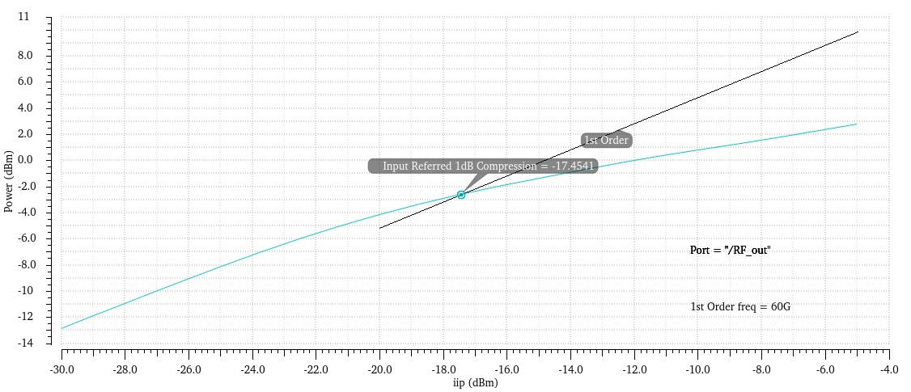
The difference of 1 dB occurs at -17 dBm. The gain saturates or starts decreasing by further increase of input power. The saturated or overdriven amplifier generates signals that are of least preference in addition to required signal which is defined as Intermodulation Distortion (IMD).
1-dB Compression Point

Slide 35
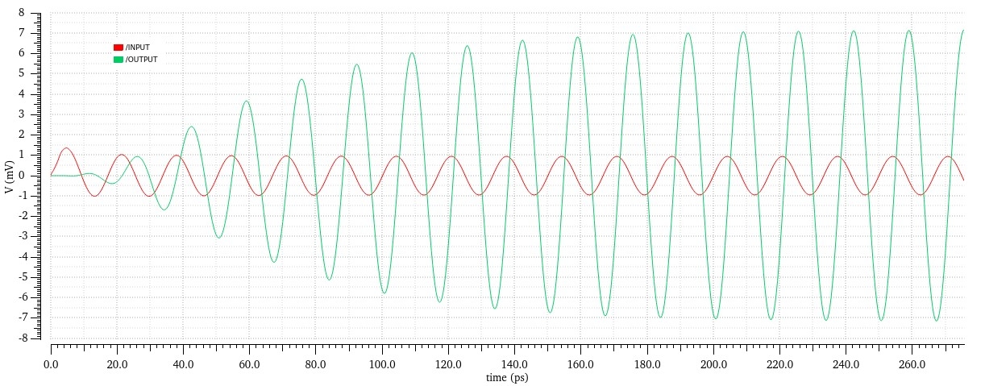
Transient Analysis
Transient response of proposed circuit is show in plot. Simulation run for 3ns and observation is recorded. We got VP-P sweep of 14 mV for 2mv VP-P input.
Transient Response Of LNA

Slide 36
Comparison With Other LNAs
Parameter | [2] | [4] | [5] | [7] | This Work
Stage/ Topology | 2/CB & CE | 2/Cascode | 3/CS | 2/Cascode | 2/Cascode
Freq. (Ghz) | 61.5 | 58 | 60 | 60 | 60
S21(dB) | 14.7 | 14.6 | 12.2 | 16.34 | 17.5
NF(dB) | 4.5 | 5.5 | 6.5 | 3.57 | 4.5
S11(dB) | -6.0 | -7.5 | -5.0 | -8.75 | -21.1
S22(dB) | -17.0 | -7.0 | -5.0 | -5.5 | -24.5
S12(dB) | -40 | -32 | -40 | -- | -39.7
P1dB (dBm) | -20 | -- | +4 | -19 | -17
Bandwidth (GHz) | 59-62 | >13 Ghz | -- | 58.5-63 | 54.5-64

Slide 37
Conclusion
In this project, various issue of LNA, as well as other critical blocks such as matching networks and source degeneration have been studied. And, a two stage cascode LNA in 90 nm technology working at 60GHz operating frequency is being constructed and the design was validated using the Cadence simulation tool as according to mentioned objectives.
As LNA in these frequency bands is still developing, hence some future work recommended. By investigating the performance trade-offs line Gain Vs Noise Figure in V-Band further, substantial power consumption can be reduced in the future.
Also, this project uses general purpose (gpdk090) silicon transistor model for LNA implementation. Noise Figure can be significantly improved by using RF specific transistors like tsmc RF-nmos.

Slide 38
References
[1] | G Spectrum – Public Policy Position”, GSMA, London, UK, November 2016.
[2] | B. A. Floyd, et al., “SiGe Bipolar Transceiver Circuits Operating at 60 GHz,” IEEE J. Solid State Circuits, Vol. 40, No. 1, 2005, pp. 156-167.
[3] | Behzad Razavi, “A millimeter-wave CMOS heterodyne receiver with on-chip LO and divider,” IEEE Journal of Solid-State Circuits, vol. 43, no. 2, pp. 477- , Feb 2008.
[4] | Terry Yao1, Michael Gordon, Kenneth Yau1, M.T. Yang, and Sorin P. Voinigescu, “60-GHz PA and LNA in 90-nm RF-CMOS,” In Proceedings of the IEEE Radio Frequency Integrated Circuits Symposium (RFIC2006), pp. 4, June 2006.
[5] | B. Heydari et al., “Millimeter-Wave Devices and Circuit Blocks up to 104 GHz in 90 nm CMOS,” IEEE J. Solid-State Circuits, Vol. 42, No. 12, 2007, pp. 2893-2903.
[6] | H. Gao, et al , “A 48–61 GHz LNA in 40-nm CMOS with 3.6 dB minimum NF © employing metal slotting method,” IEEE Radio Frequency Integrated Circuits Symposium, Vol.14, No.5,pp 154–157 March 2016.
[7] | Design and Analysis of Cascode LNA for 60 GHz Wireless Applications, International Journal of Innovative Technology and Exploring Engineering (IJITEE) ISSN: 2278-3075, Volume-8 Issue-9, July 2019

Slide 39
THANK YOU

